Slide 1

F# in the Brave New World
Tomas Petricek @tomaspetricek
Conspirator behind http://fsharp.org

Slide 2
software stacks trainings teaching F# user groups snippets mac and linux cross-platform books and tutorials
F# Software Foundation
F# community open-source MonoDevelop
http://www.fsharp.org
contributions research support consultancy mailing list

Slide 3

Who uses F# and why should you?
Concurrent & Asynchronous
Gaming, Finance
Business logic & Data
Insurance, Researchers, Machine learning, Finance
Testing & Scripting
Financial companies
F# Deep Dives http://manning.com/petricek2

Slide 4

The Data

Slide 5

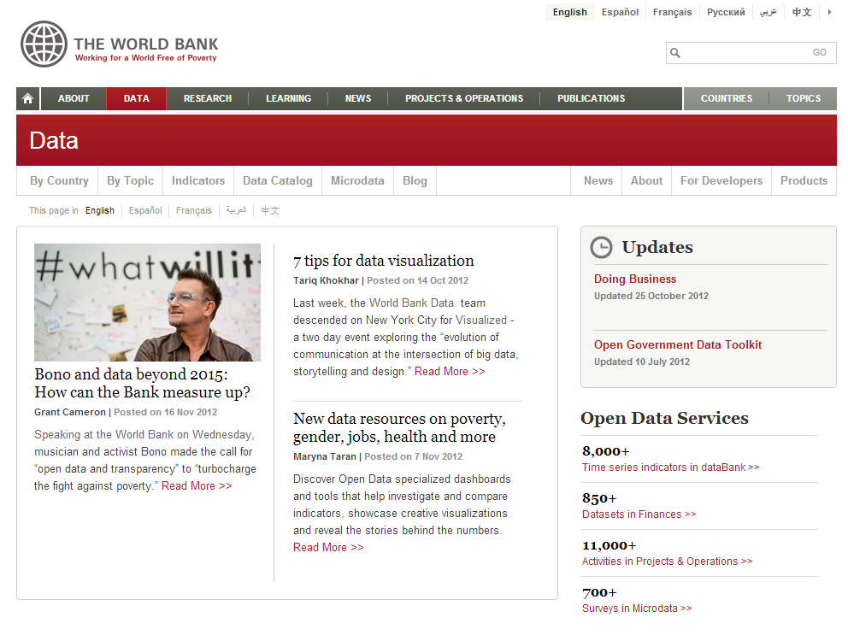
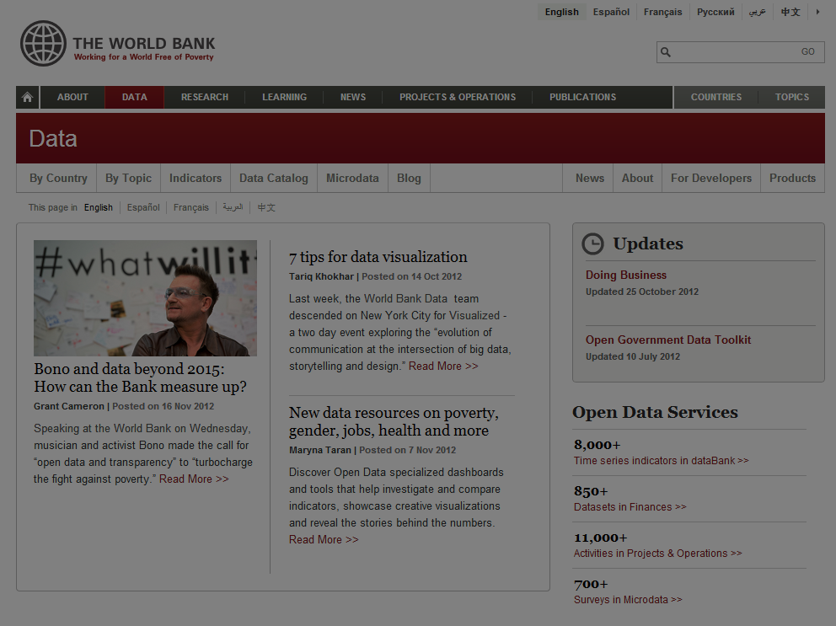

Slide 6
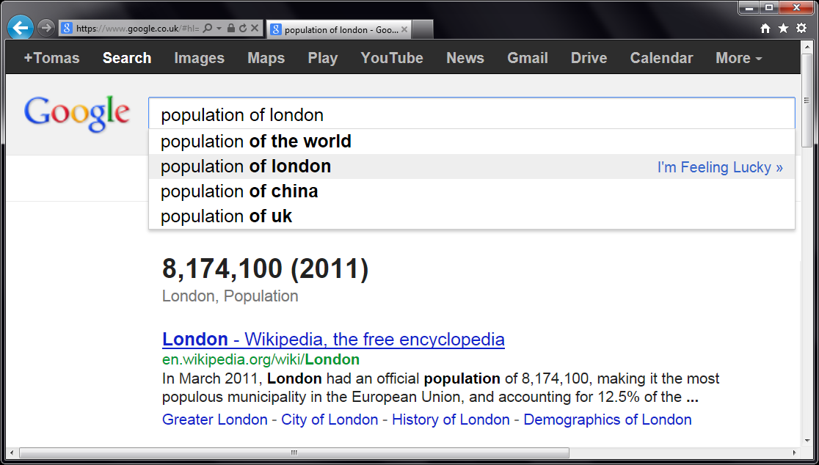
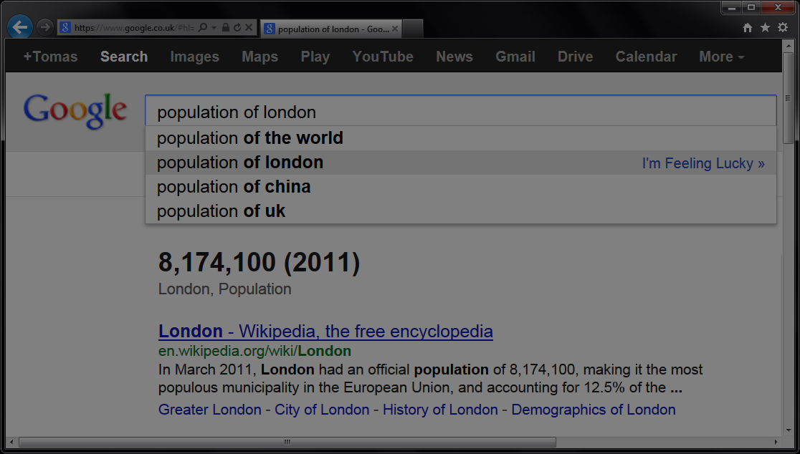


Slide 7
let wb = WorldBank()
w
b
.

Slide 8
[DEMO]
Exploring WorldBank Data

Slide 9
Asynchronous programming
Asynchrony matters
Node.js and C# 5.0
F# Async workflows
Without inversion of control
Exception handling and loops simple
Sequential and parallel composition

Slide 10
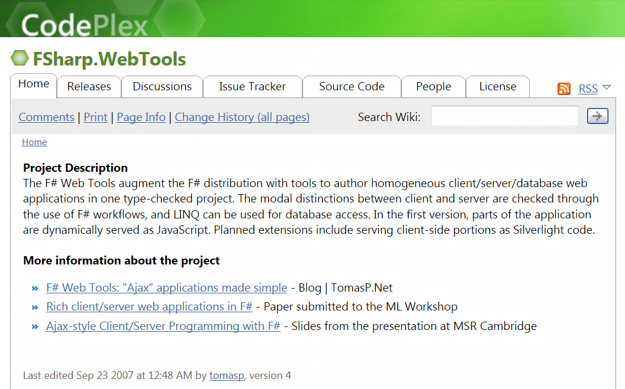
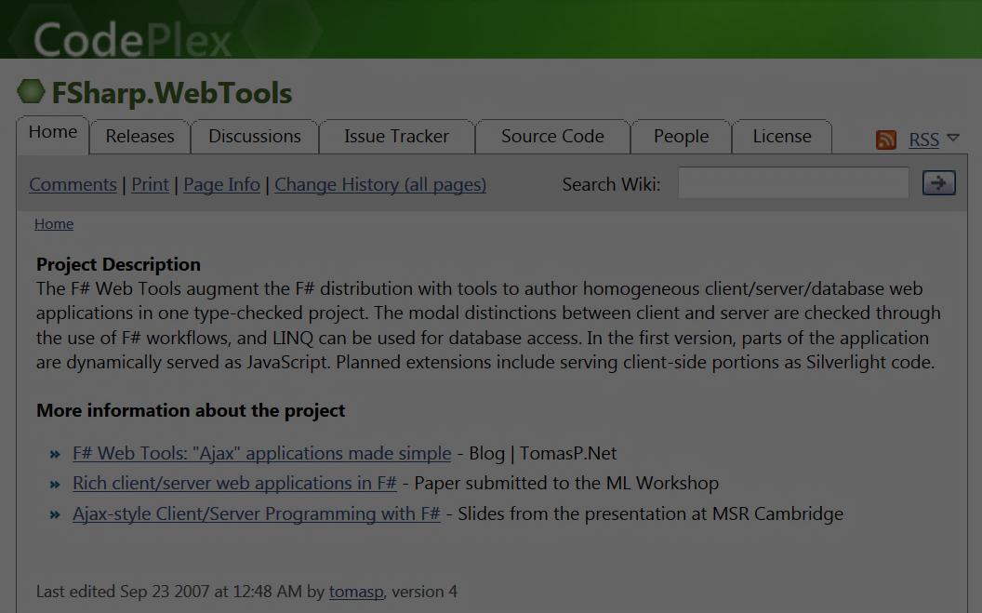

F# to JavaScript
“Before it was cool.”

Slide 11
[DEMO]
WorldBank App for the Web
http://tomasp.net/warmcroc

Slide 12
F# to JavaScript
TypeScript type provider
Import types for JS libraries
Somebody else writes them!
Libraries & frameworks
Open source: FunScript and Pit
Commercial: IntelliFactory WebSharper

Slide 13
Accessing REST services
REST (Representational State Transfer) is a style of software architecture for distributed systems such as the World Wide Web. REST has emerged as a predominant Web service design model.

Slide 14
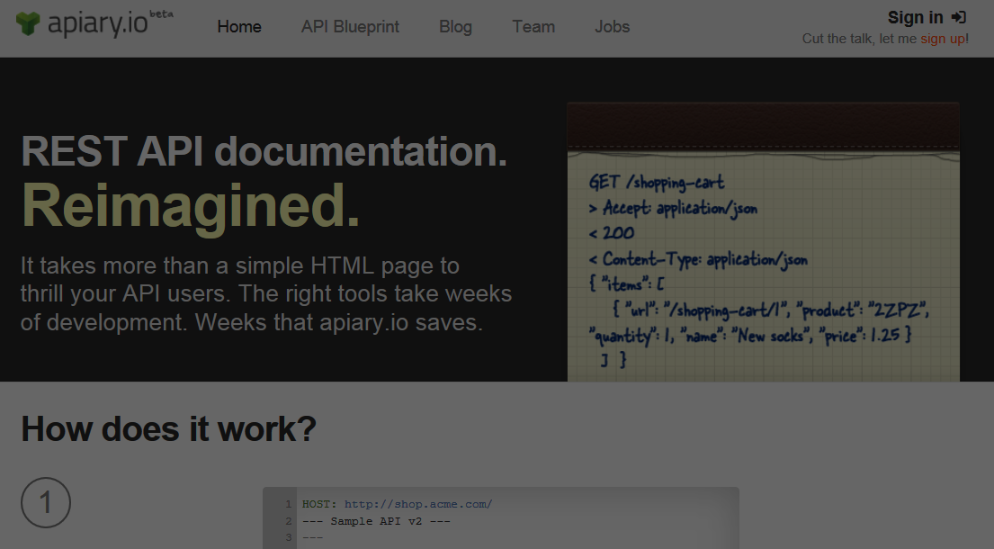
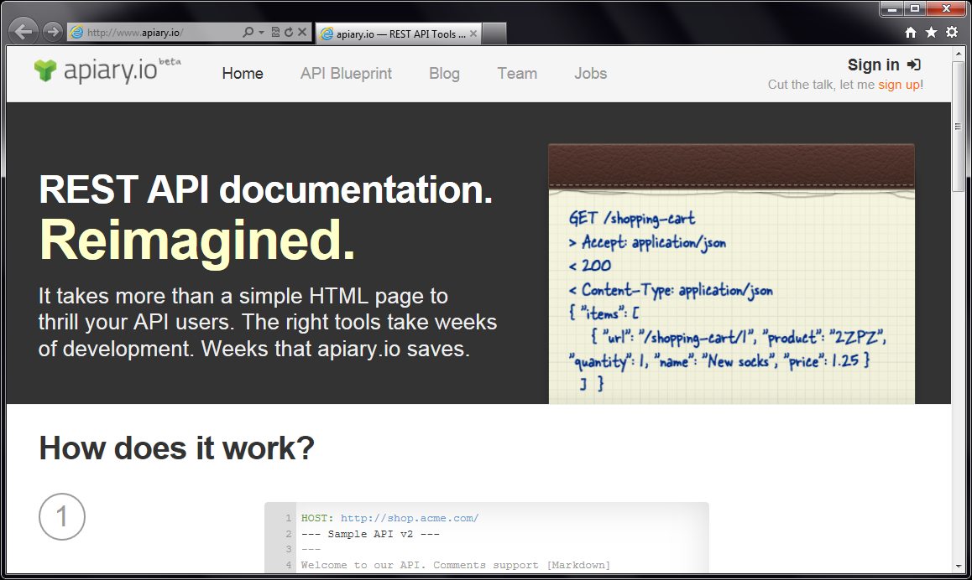
Accessing REST services

Slide 15
[DEMO]
Introducing Apiary Type Provider

Slide 16
Apiary.io Type Provider
Common REST conventions
GET /movie/{id} Get movie summary
GET /movie/{id}/casts Get cast details
Types from JSON samples
{ "page": 1, "total_pages": 1, "total_results": 5,
"results": [ { "title": "Skyfall", "id": 94221 } ] }

Slide 17
[DEMO]
The Movie Database Web App
http://tomasp.net/warmcroc

Slide 18
Type Providers in Action
WorldBank Type Provider
JSON Type Provider
Apiary Type Provider
TypeScript Type Provider

Slide 19
[SUMMARY]
Where to learn more?

Slide 20
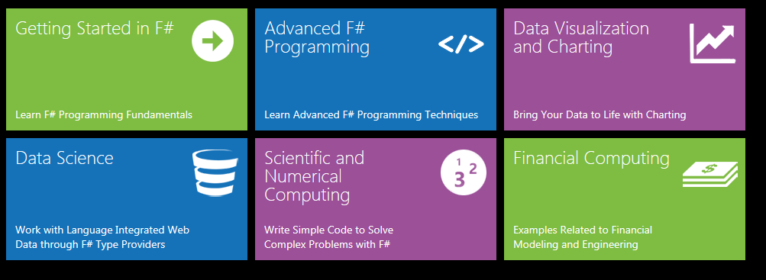
Online resources
www.fsharp.org Information & community www.tryfsharp.org Interactive F# tutorials

Slide 21

Trainings & Learning
Functional and F# trainings
London, New York or on-site
Get in touch tomas@tomasp.net
Upcoming F# Deep Dives book
http://manning.com/petricek2

Slide 22
F#, Data and Services
other languages web type script REST
R language transparent java script
tool support extensibility code-first unstructured data static typing inference schema
Love the Data
and integration

